Slide 1



Welcome to Intro to DOM!
We will begin shortly.
As you’re coming in…
Please have your camera on, if possible and change your name on Zoom to include your pronouns
Drop into the Zoom chat: what are your plans for the weekend?

Slide 2
Agenda:
<5 min> Opening
<30 min> Adding HTML + CSS to our To-Do List
<5 min> Sharing Our CSS + Getting Feedback
<15 min> Continued Worktime
<5 min> Break
<30 min> Adding Functionality to our To-Do List
<10 min> Sharing our To-Do List
<15 min> Close-Out

Slide 3
Continuing Our To-Do List

Slide 4
Your Task
Build a to-do list using HTML, CSS, and JavaScript.
Your To-Do list will include:
A space to type a to-do
Add the item to an ongoing list
Mark an item as complete

Slide 5
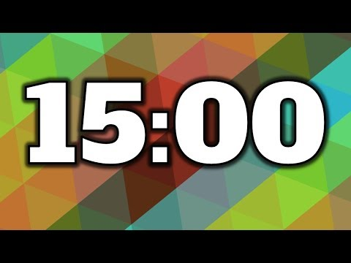
Adding CSS to our To-Do List
Tara’s going to start by sharing with you how to change font
The other CSS is up to you!
Background color
Changing button styles
Adding divs
Adding images
Adding titles
There are resources in our Links & Resources!
Notes:
Hannah: please create 3 breakout rooms
Tara to drop into chat:
Main Room: I’m good to go, I can code this on my own and would like to do it silently !
Breakout Room 1: I’d like to mostly code on my own, but I’ll work with others if needed!
Breakout Room 2 with Tara: Let’s code-along a to-do list together!
Breakout Room 3 with Hannah: Stop by if you have any specific questions

Slide 6
Breakout Rooms
<5 minutes> Groups of 2
~ 2 minutes per person
Share your output/website via sharing your screen
Share your code
Answer any questions that other people in the group may have!
Give feedback because once we come back, you’ll get a chance to implement that feedback!
Notes:
HANNAH MAKES BREAKOUT ROOMS
<5 minutes>
Share your output/website via sharing your screen
Share your code
Answer any questions that other people in the group may have!
Give feedback because once we come back, you’ll get a chance to implement that feedback!

Slide 7
Continued Worktime
Now that you’ve seen others’ work, you get time to either implement the feedback or implement what you’ve been inspired by!

Slide 8
Adding Functionality to Our To-Do List

Slide 9
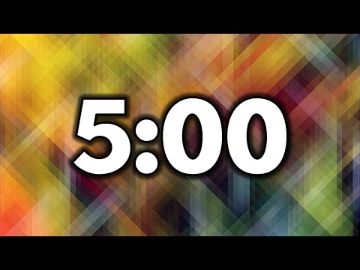
Break

Slide 10
Codealong with Tara!

Slide 11
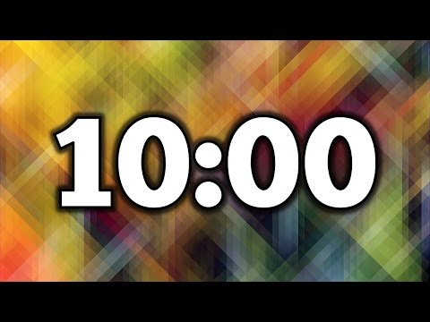
Finishing Touches on Our To Do List!
Edit any of the HTML, CSS, or JS of your To-Do List!

Slide 12
Sharing Our To-Do Lists
Please add your to-do list to the deck
Check out other peoples’ to do lists! Please praise as comments or in the speaker notes to at least 3 other projects.

Slide 13
Congratulations to our graduates!

Slide 14
Congratulations Ashley!
On the completion of the Girl Develop It! Introduction to DOM Course on July 15, 2022

Slide 15
Congratulations Reecey!
On the completion of the Girl Develop It! Introduction to DOM Course on July 15, 2022

Slide 16
Congratulations Kat!
On the completion of the Girl Develop It! Introduction to DOM Course on July 15, 2022

Slide 17
Congratulations Laura!
On the completion of the Girl Develop It! Introduction to DOM Course on July 15, 2022

Slide 18
Congratulations Alexis!
On the completion of the Girl Develop It! Introduction to DOM Course on July 15, 2022

Slide 19
Congratulations Catherine!
On the completion of the Girl Develop It! Introduction to DOM Course on July 15, 2022

Slide 20
Congratulations Gillian!
On the completion of the Girl Develop It! Introduction to DOM Course on July 15, 2022

Slide 21
Congratulations Francine!
On the completion of the Girl Develop It! Introduction to DOM Course on July 15, 2022

Slide 22
Congratulations Lori!
On the completion of the Girl Develop It! Introduction to DOM Course on July 15, 2022

Slide 23
Congratulations Traci!
On the completion of the Girl Develop It! Introduction to DOM Course on July 15, 2022

Slide 24
Closing Out

Slide 25
Course Sequence
Day 1 - Tuesday
Introduction to the course
Introduction to DOM
Learning about DOM events and event listeners
Using browser (Chrome/Firefox) Developer Tools
Wireframing and coding the HTML & CSS of a to-do list app
Day 2 - Wednesday
Responding to user interactions on our web pages
Adding elements to the DOM to create a to-do list app
Day 3 - Friday
Querying and updating a page after it’s loaded
Adding finishing touches to our to-do list app
Final presentations
✅
✅
✅

Slide 26
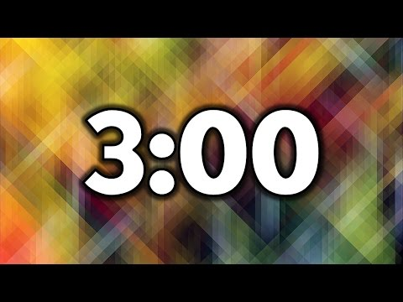
Final Class Survey
Notes:
🔗 End of class survey: https://docs.google.com/forms/d/e/1FAIpQLSdqLozzTQpe_KCElW796iggJbSbA41IaXZ0J9PAtdWwLyqhCw/viewform

Slide 27
Round Robin Closeout
Please put your camera on if you’d like to participate!
Answer these questions:
What is something that you’re taking away?
What do you hope to do now that you’re done with this course?
Popcorn to someone else!
Turn your camera off so we know you’ve already gone.
Notes:
🔗 Please head to this Padlet and answer the questions: https://padlet.com/taratptran/domsession1

Slide 28
Next Steps
Fill out the end of course survey.
Email Tara or Hannah if you have any questions
Keep on keeping on with the awesome coding work!
Please keep in touch and check out the other GDI opportunities.
Notes:
🔗 End of class survey: https://forms.gle/AWAGrJP5xPxysiEc7

